Slide 1
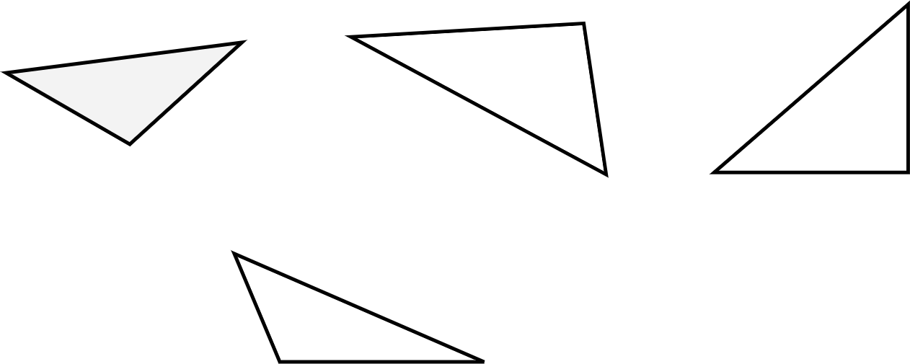
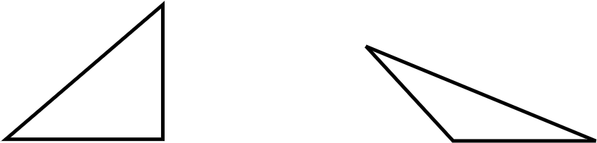


Using the formula for the area of a triangle
Task A: Calculating the area of a triangle
1) Calculate the area of each triangle.
a) b) c)
4 cm
5 cm
5 cm
2 cm
3 cm
2.5 cm
4 cm
5 cm
4 cm
d)
3.5 cm
1.2 cm
4.2 cm
a) Area = ½ × 2.5 × 4
= 5 cm²
b) Area = ½ × 2 × 5
= 5 cm²
c) Area = ½ × 3 × 4
= 6 cm²
d) Area = ½ × 3.5 × 4.2
= 7.35 cm²
2) Write an expression for the area of each triangle.
a) b)
Area = Area =
3

Slide 2
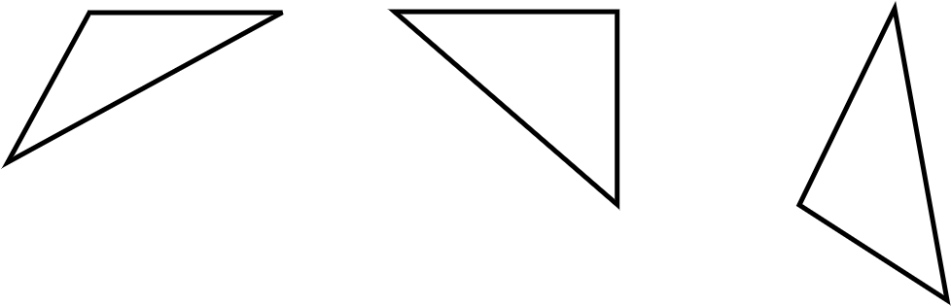
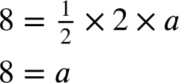
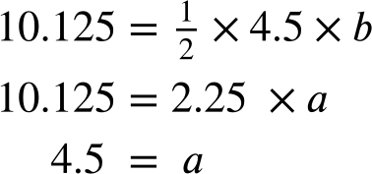
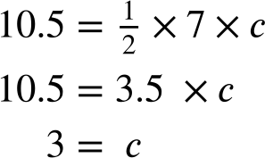
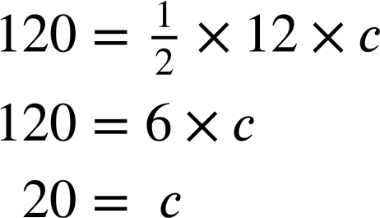
Using the formula for the area of a triangle
Task B: Calculating a slide length
1) Calculate the missing side length for each triangle.
a) b) c)
Area = 8 cm² Area = 10.125 cm²
Area = 10.5 cm²
2 cm
4.5 cm
6 cm
7 cm
5 cm
2) A triangle has an area of 120 cm². It has a height of 12 cm. What is the length of its base?
3) Another triangle also has an area of 120 cm². What could the lengths of its base and height be? Try to come up with a unique pair of lengths.
a) The missing length measures 8 cm
b) The missing length measures 4.5 cm
c) The missing length measures 3 cm
2) The length of the base is 20 cm
3) Any pair of numbers that have a product of 240 will work.
Mathematics in Education and Industry.

